Slide 1

Learning Objectives
Circular Motion
Multiple Objects
Make 3D elements move in circles that never stop
Make multiple elements move at the same time
Speed Variation
Make elements move at different speeds
Notes:
https://edu.delightex.com/TDN-RVH

Slide 2
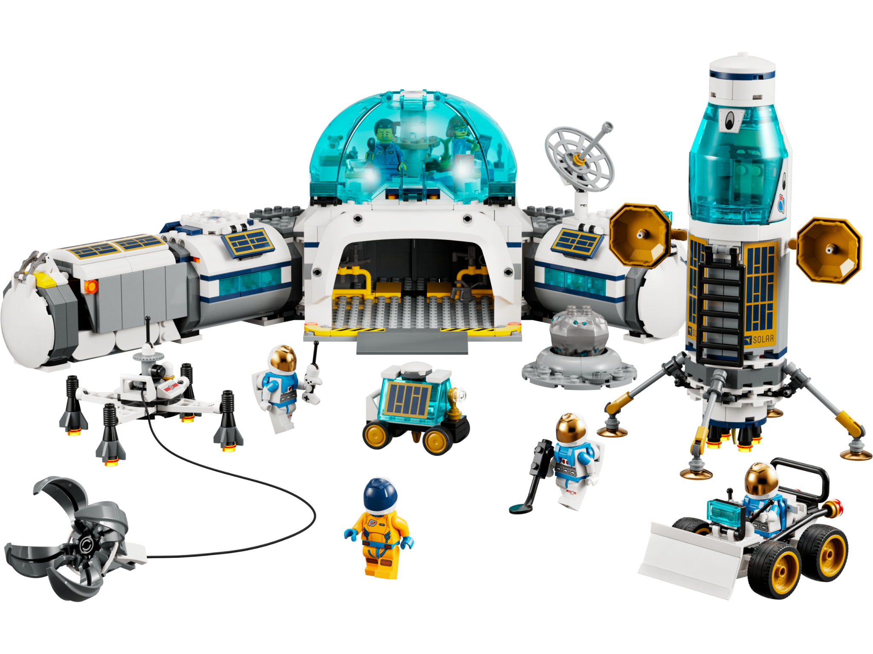
An element is just a fancy word for a thing in your project. It could be:
A 3D object like a rocket, planet, or astronaut
A character that moves or talks
A button that you click
A sound, image, or text you add
Think of elements like LEGO pieces — you use them to build your digital world

Slide 3






Key Concepts
Paths, Forever Loops, Parallel Processing
Paths
Forever Loops
Parallel Processing
Train tracks or race car circuits. Objects follow predetermined routes.
A ferris wheel that never stops spinning. Continuous, repeating motion.
A marching band. Everyone plays their part at the same time.

Slide 4

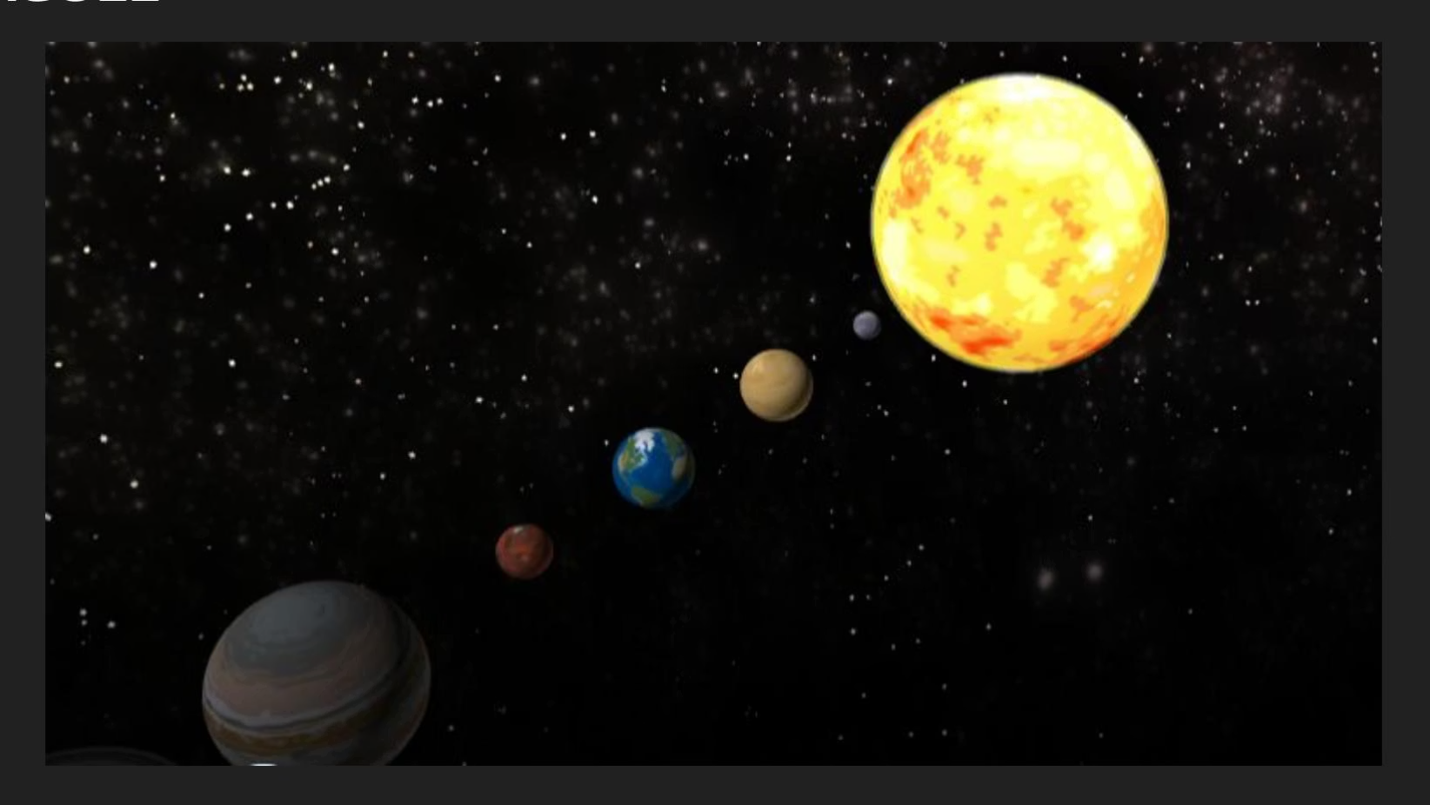
Parallel Process in Real Life
CPU vs GPU
WAGOLL
https://edu.delightex.com/XUX-KFG
What A Good One Looks Like
Notes:
https://edu.delightex.com/XUX-KFG

Slide 5
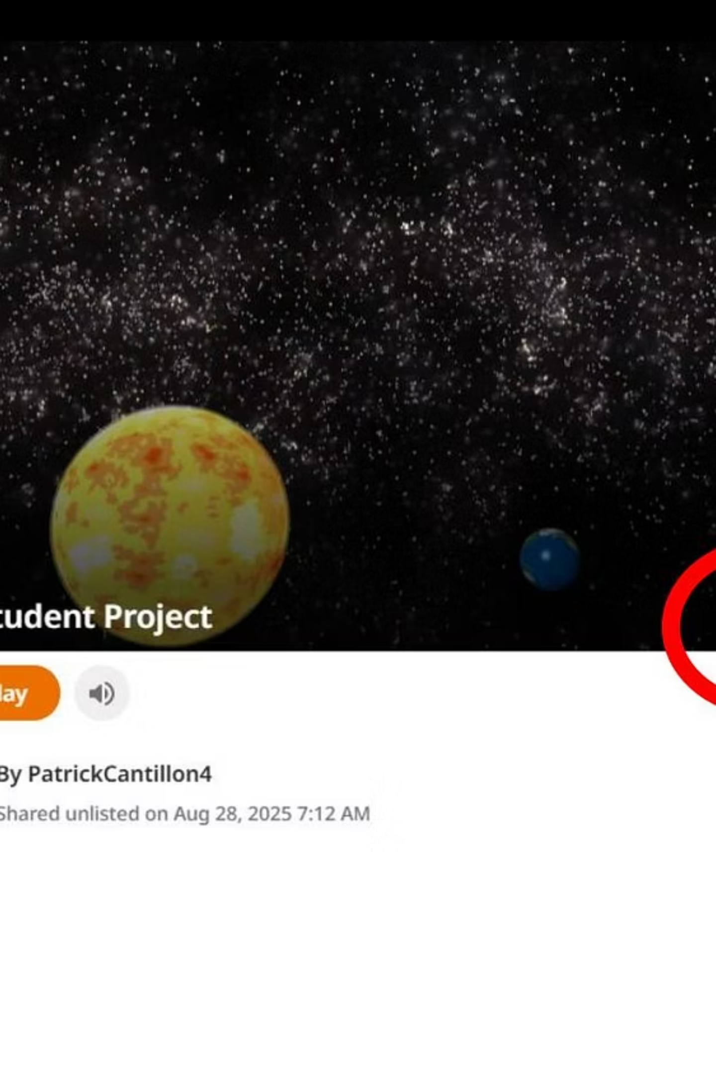
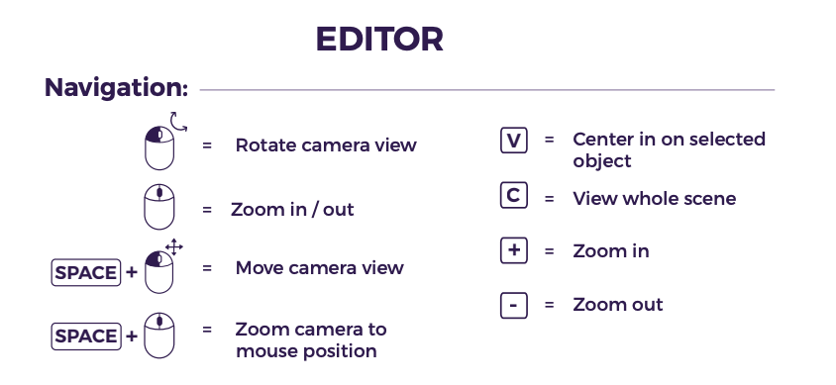
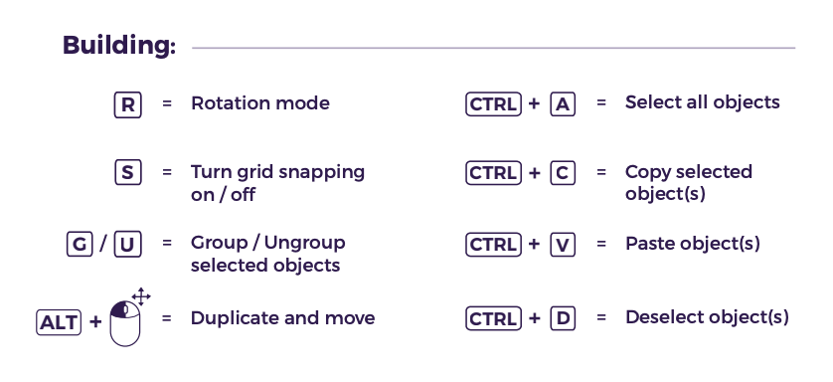
Notes:
Student Template https://edu.delightex.com/TDN-RVH

Slide 6

Lets move the Earth & Sun
01
02
03
Center the Sun
Earth's Orbit
Add Rotation
Put the Sun in the center (it's the biggest!)
Make Earth go around the Sun using forever blocks
Earth moves on a path and rotates
Notes:
Model this to students
https://edu.delightex.com/TDN-RVH

Slide 7
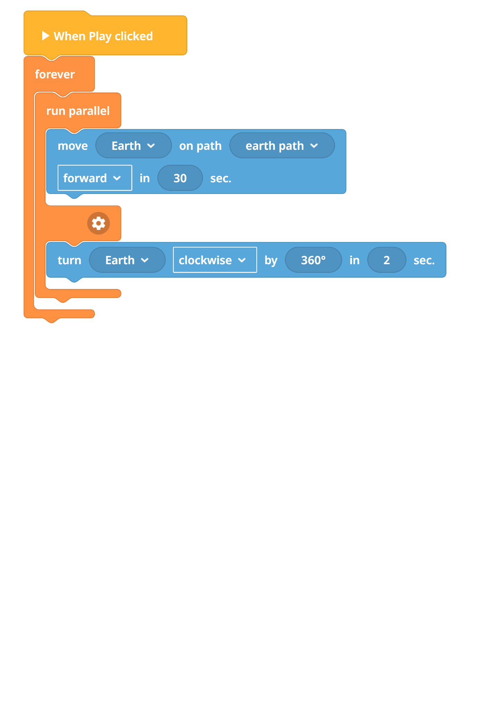
Code Structure
Building Your Animation
Create circular paths for each object
Set different duration for movement and turning
Use run parallel so all objects move & rotate at once

Slide 8
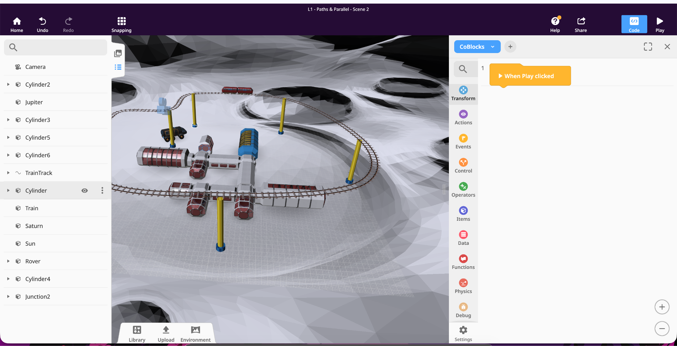
Your Mission: Use Parallel processing to make the Rover & Train move
Notes:
https://edu.delightex.com/TDN-RVH

Slide 9




Extension: Complete Solar System
Add Inner Planets
Add Outer Planets
Planet Rotation
Mercury, Venus, Earth, Mars using run parallel with different speeds
Jupiter, Saturn, Uranus, Neptune with forever blocks
All planets spinning on their axes

Slide 10




Plenary
Today's Achievements
Smooth Animations
Parallel Processing
Created smooth animations
Used parallel processing for multiple objects
Realistic Timing
Applied realistic timing relationships

